Slide 1


Action Plan for
Cambodian
SDG 2 and SDG 3
JICA Short-term Training Program: Innovative Asia

Slide 2
Contents
Introduction
Cambodian Goals and Targets
Situation Analysis
Action Strategies
Monitoring and Evaluation
Case Studies

Slide 3
1.
Introduction

Slide 4
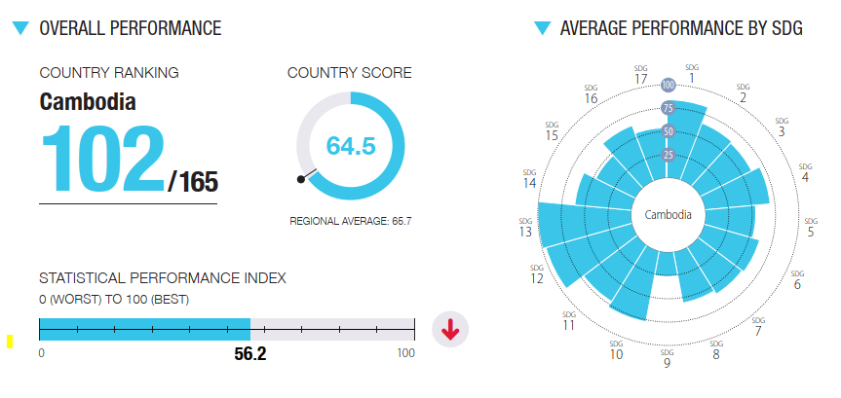
Cambodian SDG and Trend

Slide 5
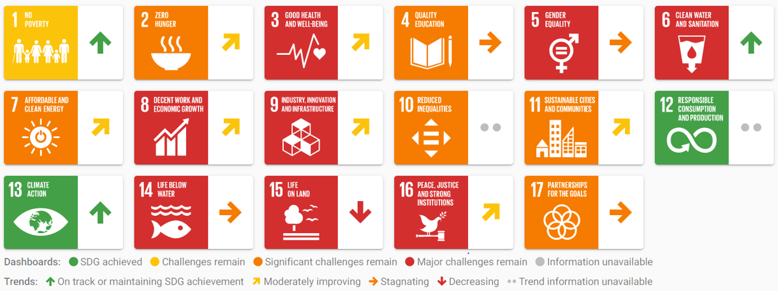
Cambodian SDG and Trend

Slide 6
2.
Goals and Targets

Slide 7
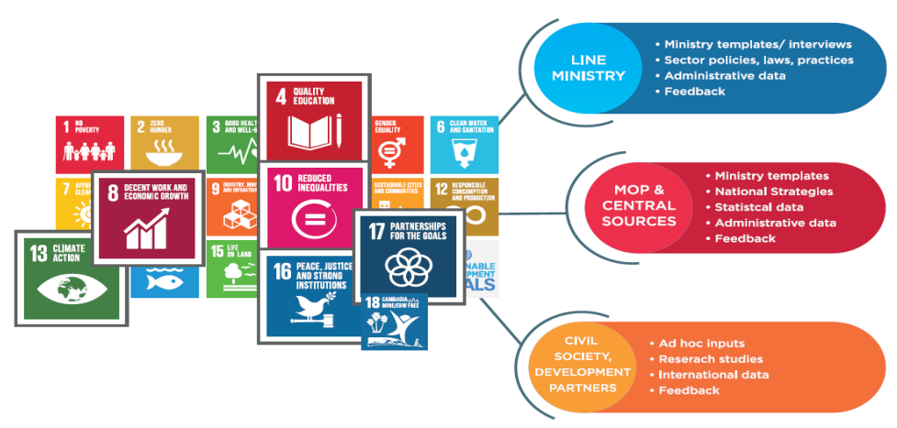
Cambodian Volunteering National Review (VNR) on SDG 2030 Agenda
VNR process adopted an open and inclusive approach. It relied on a wide variety of quantitative and qualitative information provided from a number of stakeholder sources.

Slide 8
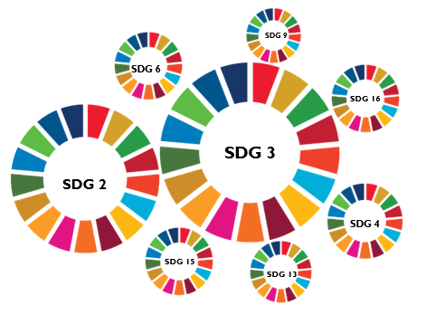
Cambodian SDG and Targets
CSDG 3: Ensure healthy lives and promote well-being for all ages
CSDG 2: End Hunger, Achieve Food Security and Improved Nutrition and
Promote Sustainable Agriculture
Cambodia SDG 2 (CSDG 2) and SDG 3 (CSDG 3) are standalone goals on health, and zero hunger which are still in major challenges for achieving the 2030 Agenda.

Slide 9
Action Plan for Improving Cambodian SDG 2 and SDG 3
Significant and major challengs in Cambodia
Malnutrition on kids, adolescent girls, and elders and food insecurity
High rate on non-communicable disease
Low agriculture productivities whole most of the population are farmers
High risk on communicable disease due to poor health-care systems
Poor food product systems and ecosystem resilience
High road traffic accident and injuries
Poor universal health coverage

Slide 10
Objectives of CSDG 2 and SCDG 3 by 2030 Agenda
(2.2) End all form of malnutrition on youngers, adolescent girls and elders.
(3.3) End all epidemics of AIDS, tuberculosis, malaria, and enhance heath care systems to other communicable diseases
(2.3) Double agriculture productivity and incomes of small-scale food producers
(3.4) Reduce by one third of non-communicable disease for people in the age of 30-70 years old
(2.4) Ensure sustainable food production systems and maintain agricultural ecosystems
(3.6) Halve the number of global deaths and injuries from road traffic accident
(3.8) Achieve universal health coverage include quality essential health care service.

Slide 11
3.
Situational Analysis

Slide 12
SWOT Analysis
STRENGTHS
Political will
Improving the governing
Staff commitment
Technology
WEAKNESSES
Lack of a proper government structure to guide department of HIS
Still lack of interdepartmental collaboration
Human resource
ICT capacity
Lack of data quality and data analysis
S
W
Political commitment to SDG 2 and SDG 3
Economic growth
ICT expansion
Internet connectivity
Availability of web and cloud based platforms
OPPORTUNITIES
Unstable funding and budget
Slow progress by related ministries
Community involvement
Software development and maintenance
Data security and standards
THREATS
O
T

Slide 13
4.
Action Strategies

Slide 14
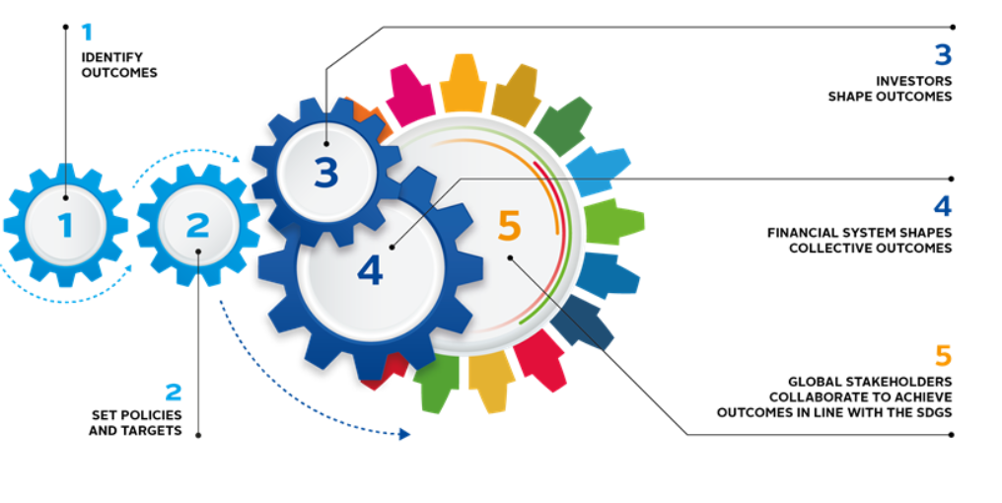
Strategies Frameworks
IDENTIFY TARGETS OR OUTCOMES
SET METTHODS OR STRATEGIES
SET FINANCIAL SYSTEMS OR BUDGET PLANS
IDENTIFY STAKEHOLDERS &
HUMAN RESOURCES
SET POLICIES OR ACTIONS

Slide 15

1
Targets and Actions on CSDG 2 for 2030 Agenda
2
TARGET OR OUTCOMES | ACTIVITIES OR INPUTS
2.2 By 2030, end all forms of malnutrition, and food insecurity including achieving, by 2025, the internationally agreed targets on stunting and wasting in children under 5 years of age and address the nutritional needs of adolescent girls, pregnant and lacing women and older persons. | Improve nutrition and promote balanced diets Enhance food security produce through crop and food production process
2.3 By 2030, double the agricultural productivity and incomes of small-scale food producers, in particular women, indigenous peoples, family farmers, pastoralists and fishers, including through secure and equal access to land, other productive resources and inputs, knowledge, financial services, markets and opportunities for value addition and non-farm employment | Enhance soil health and restore land Mainstream biodiversity conservation and protect ecosystem functions Reduce losses, encourage reuse and recycle, and promote sustainable consumption Adapt and improve investment and finance
2.4 By 2030, ensure sustainable food production systems and implement resilient agricultural practices that increase productivity and production, that help maintain ecosystems, that strengthen capacity for adaption to climate change, extreme weather, drought, flooding and other disasters and that progressively improve land and soil quality. | Strengthen innovation systems Address and adapt to climate change Strengthen ecosystem resilience

Slide 16
1
Target and Actions on CSDG 3 for 2030 Agenda
2
TARGET OR OUTCOMES | ACTIVITIES OR INPUTS
3.3 By 2030, end the epidemics of AIDS, tuberculosis, malaria and neglected tropical diseases and combat hepatitis, water-borne diseases and other communicable diseases, and Covid-19 | Improve health care system and human resource in medical fields. More specialty improves AI applications and remote sensing to support health care systems
3.4 By 2030, reduce by one third premature mortality from non-communicable diseases through prevention and treatment and promote mental health and well-being. | Improve health care system and human resource in medical fields. More specialty improves AI applications and remote sensing to support health care systems
3.6 By 2030, halve the number of global deaths and injuries from road traffic accidents. | Strengthen implementation of traffic law and infrastructures
3.8 Achieve universal health coverage, including financial risk protection, access to quality essential health-care services and access to safe, effective, quality and affordable essential medicines and vaccines for all. | Boost effective and sustainable primary health care for achieving the health-related SDG targets and progress on the other accelerator themes.

Slide 17
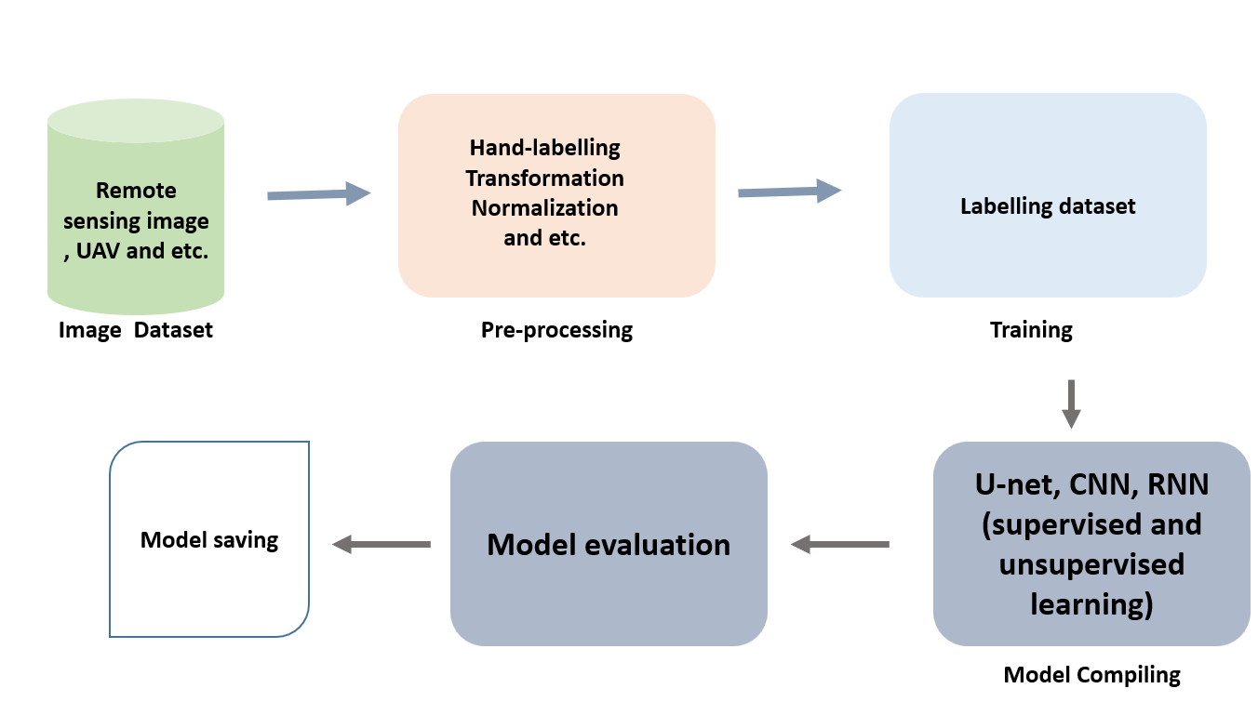
3
METHODS AND STRATEGIES

Slide 18
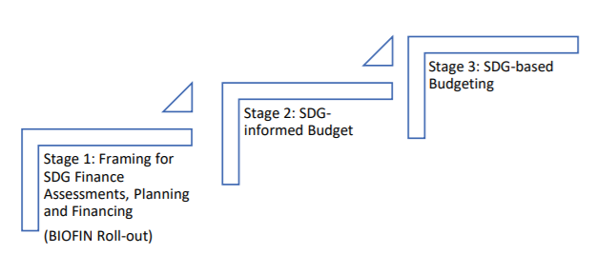
4
FINANCIAL SYSTEMS AND BUDGET PLAN
CSDG 2 | CSDG 3
WHO, USAID and, MOE, MOA, and National Bank
WHO, USAID and, MOH, and National Bank

Slide 19
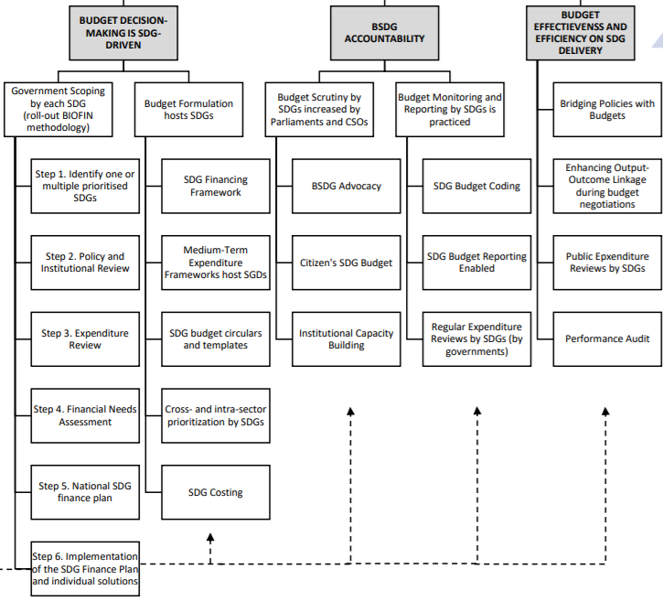
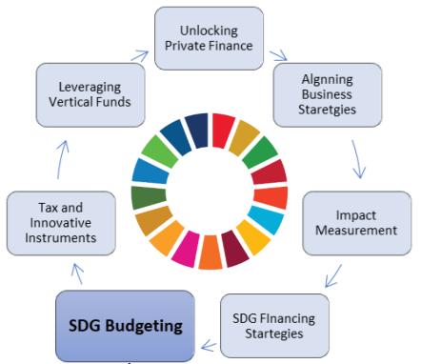
4
FINANCIAL SYSTEMS AND BUDGET PLAN

Slide 20






Stakeholders/ Task Team Members
5
STAKEHOLDERS AND HUMAN RESCOURCES
Hospitals and Healthcare System
Pharma companies
Insurance providers
Medical labs, federal and state government department and agencies
Heath information techology vendors
Healthcare consulting companies, physician offices and group

Slide 21
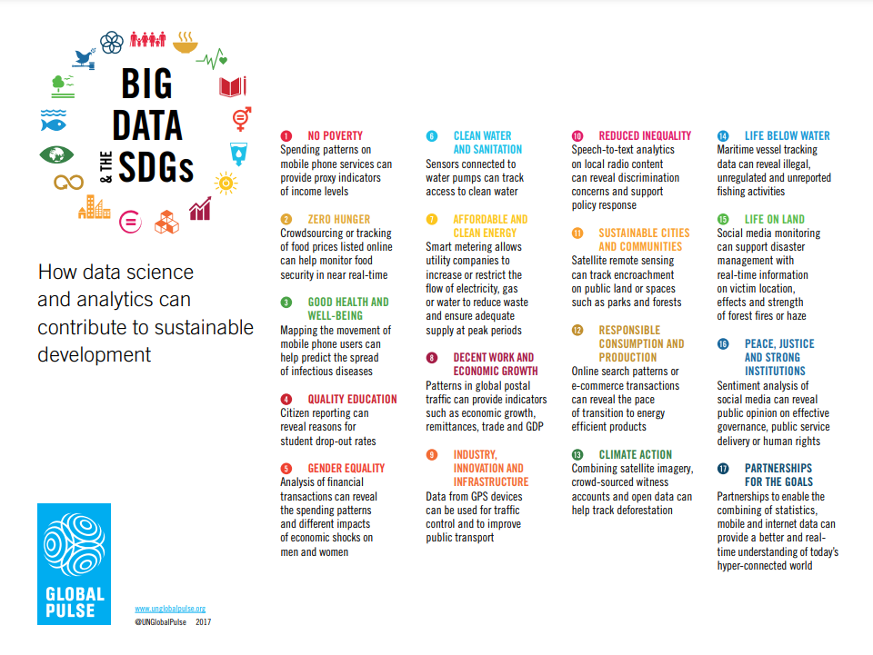

Slide 22
Resources of Data in Cambodia
Healthcare data from hospitals
Ministry of Health of Cambodia
Medical labs such as Pasteur institute of Cambodia
WHO and Global Sectors
Related ministries
Private sectors

Slide 23
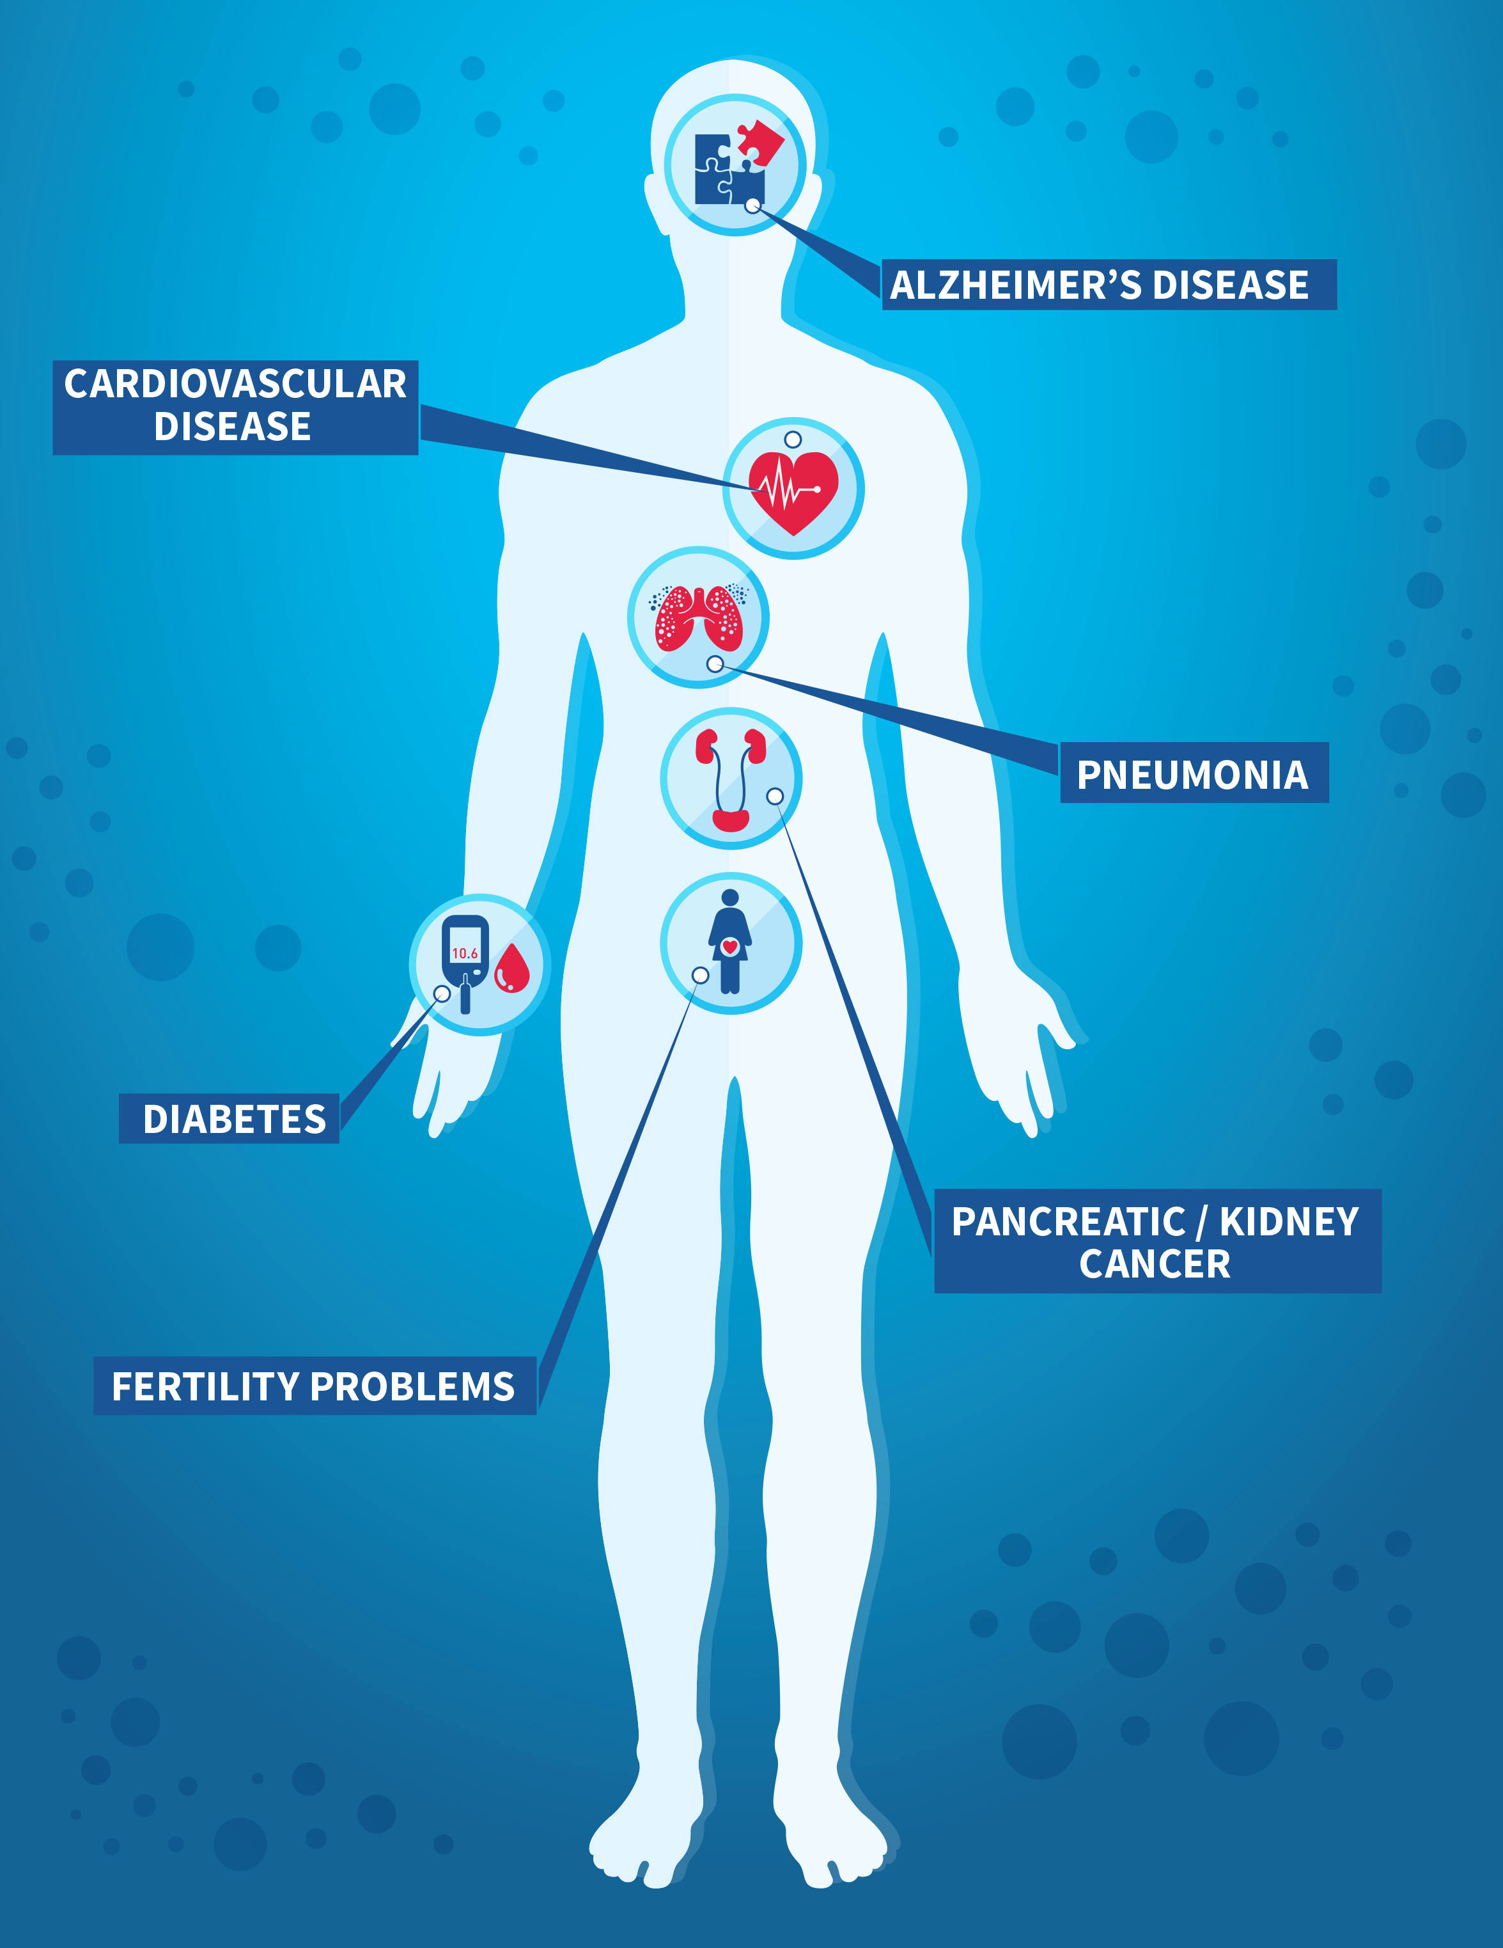
Big data for action plan
3.4 By 2030, reduce by one third premature mortality from non-communicable diseases through prevention and treatment and promote mental health and well-being (​ per 1000).
Type of Data
Unstructured data:
Medical image (x-ray, MRI, CT …)
signal (heart sound, brain wave…)
Structured Data:
patient record: (Age, gender, type of disease, duration of affected by disease)
Ministry of Health
University of health and science
Big data available online? NO!
Data collection
National hospital and medical lab

Slide 24
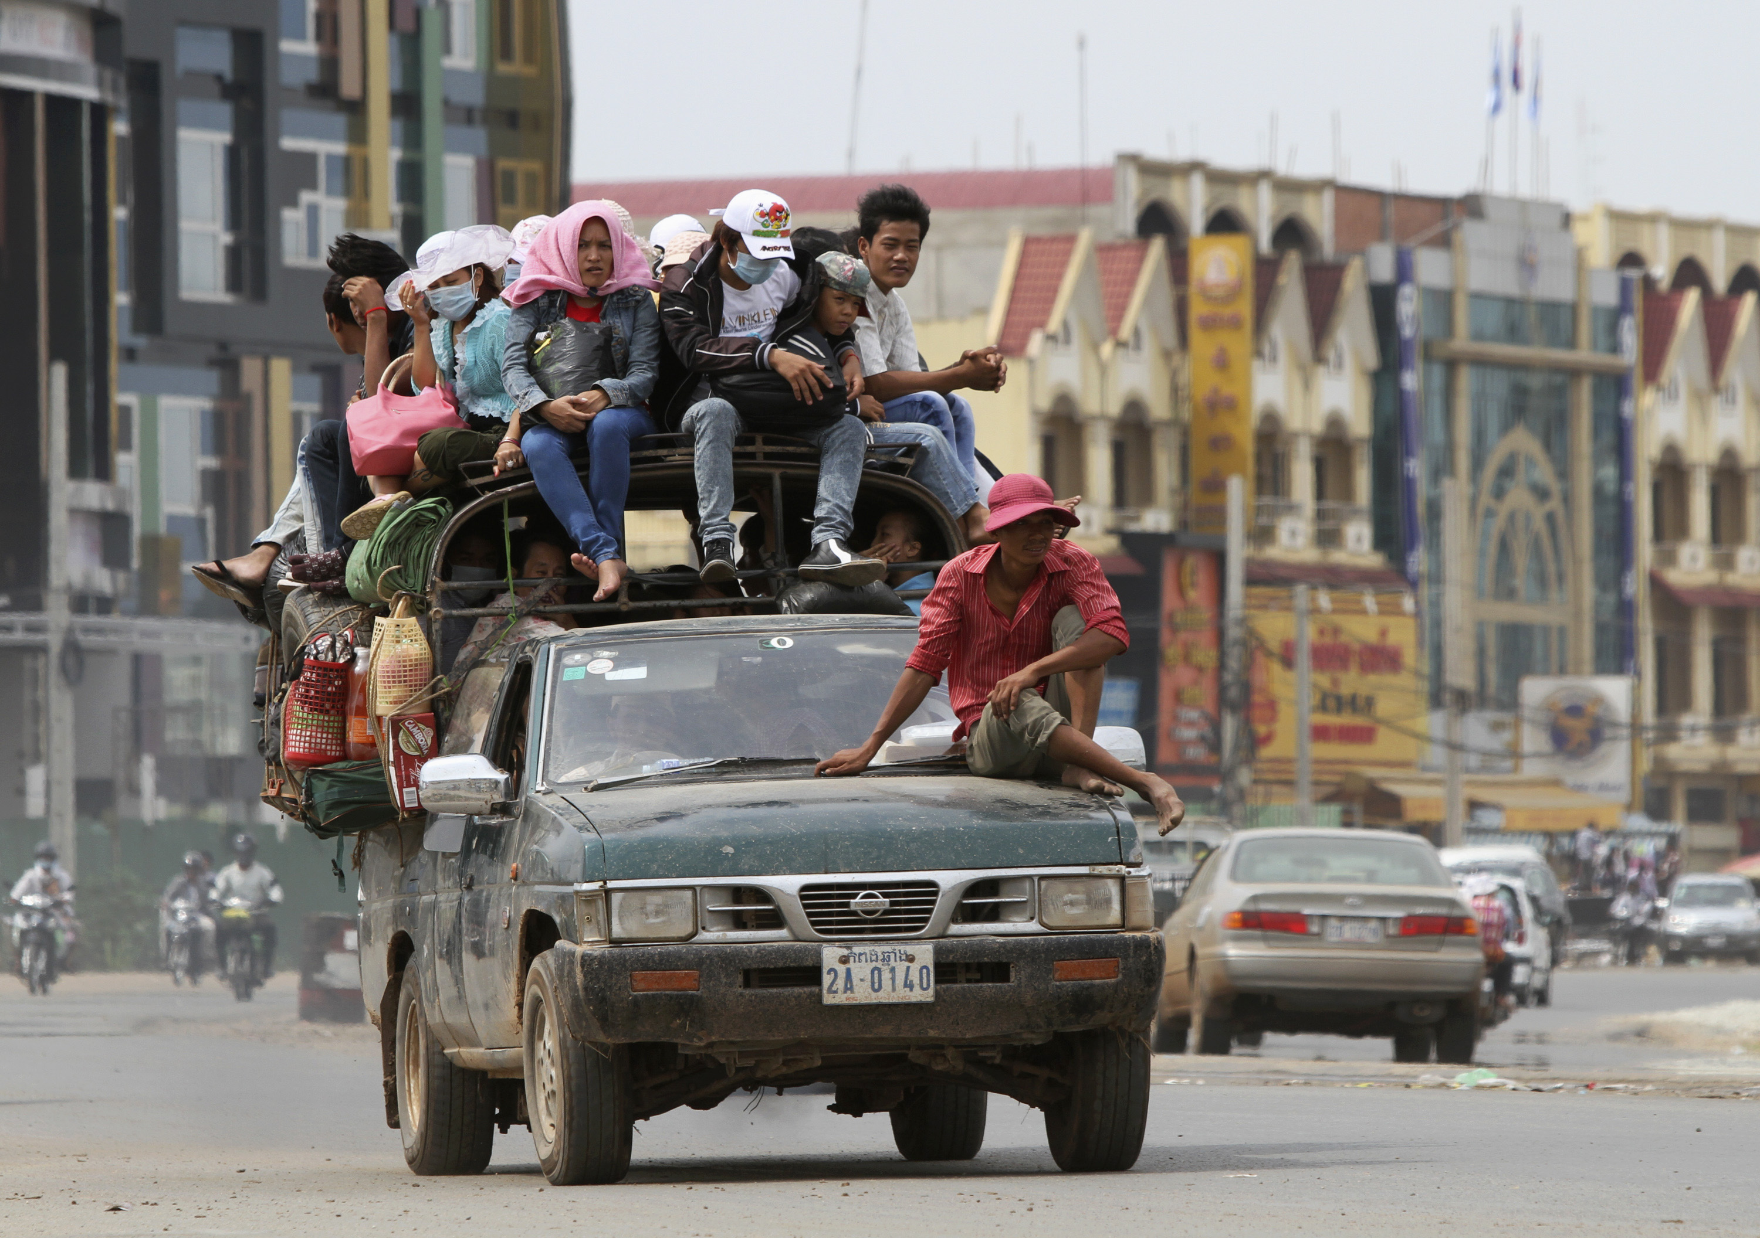

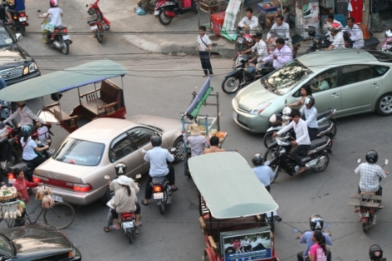
Big data for action plan
3.6 By 2030, have the number of global deaths and injuries from road traffic accidents.
Type of Data
Unstructured data:
CCTV (video and image) for analysing traffic
social media (video, voice and text)
Structured Data: (forecasting )
data contained four attributes, namely accident number, accident type, accident location and accident time.
Geographic Location is Converted to Latitude and Longitude
Ministry of Interior
Big data available online? NO!
Data collection and scrapping

Slide 25
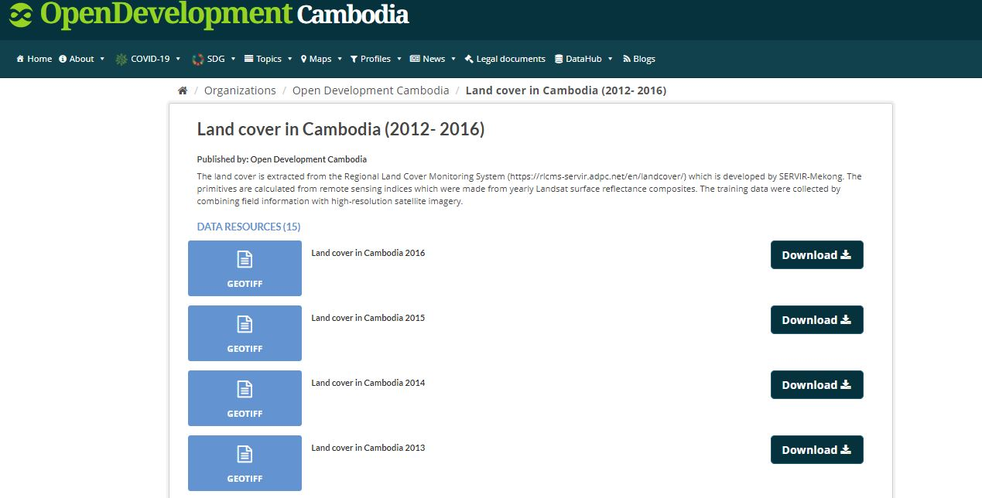
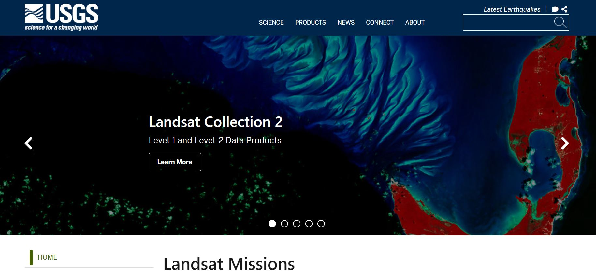
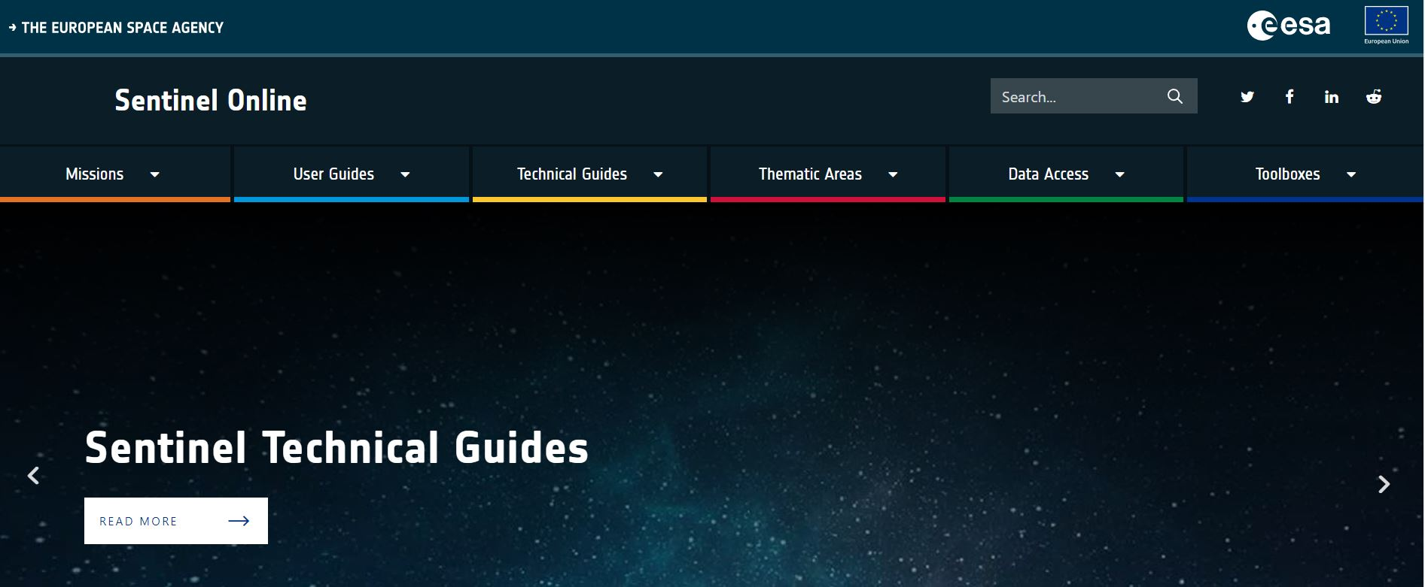
Remote Sensing Big data for action plan
Remote sensing data:
Open Development Cambodia
Landsat
Sentinel
MODIS

Slide 26
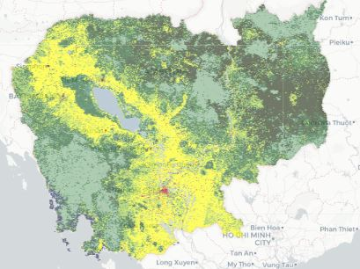
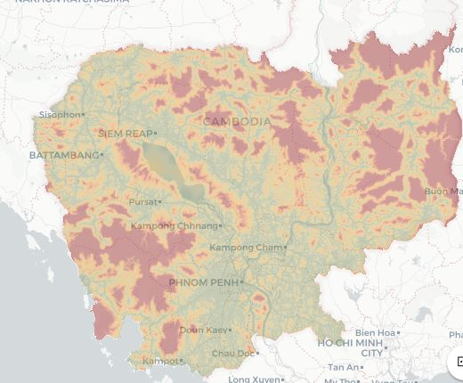
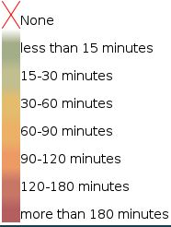
Remote Sensing Big data for action plan
HOW?
Satellite images and AI to measure the rural area community population
Used satellite image and machine learning to classify urban and rural area
Satellite images application for identify rural area community to access to health center
Using satellite image for detection air quality

Slide 27
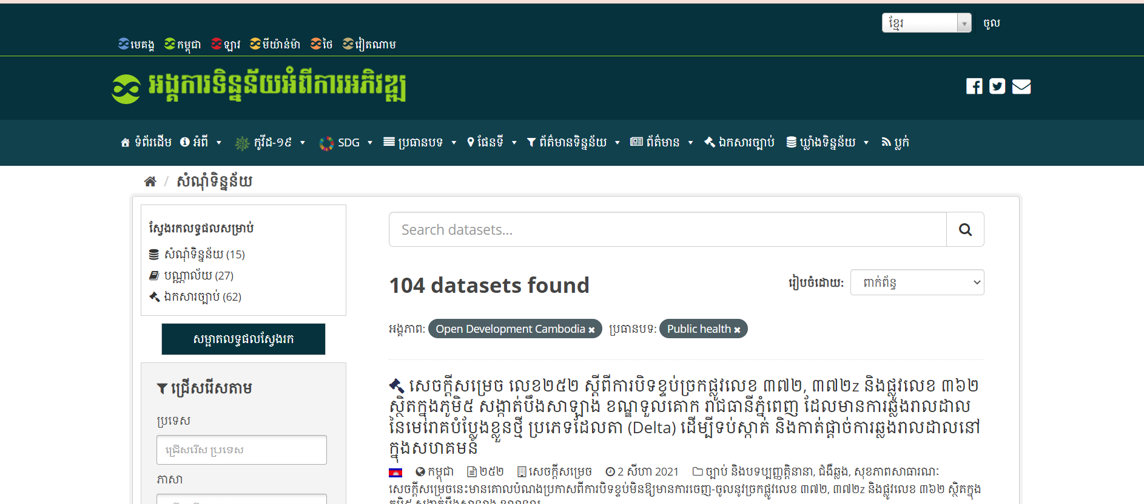
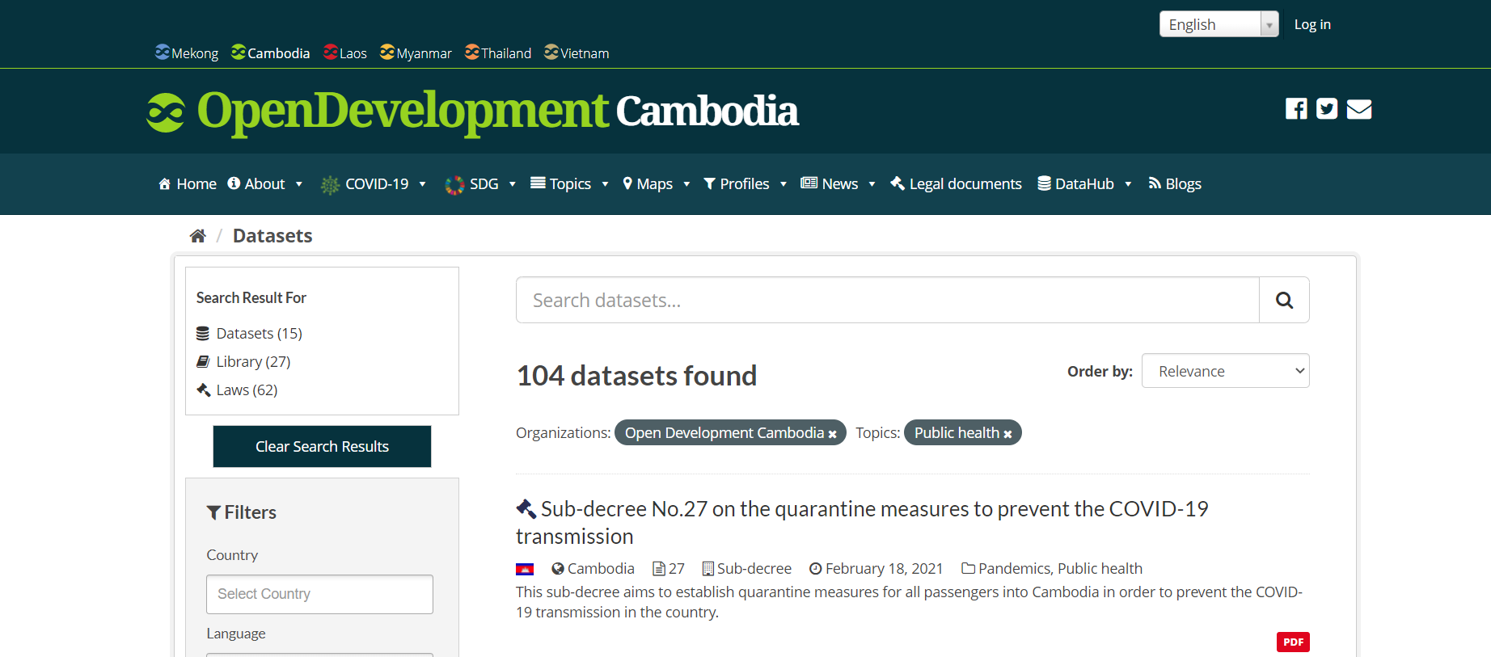
Open Data Source

Slide 28
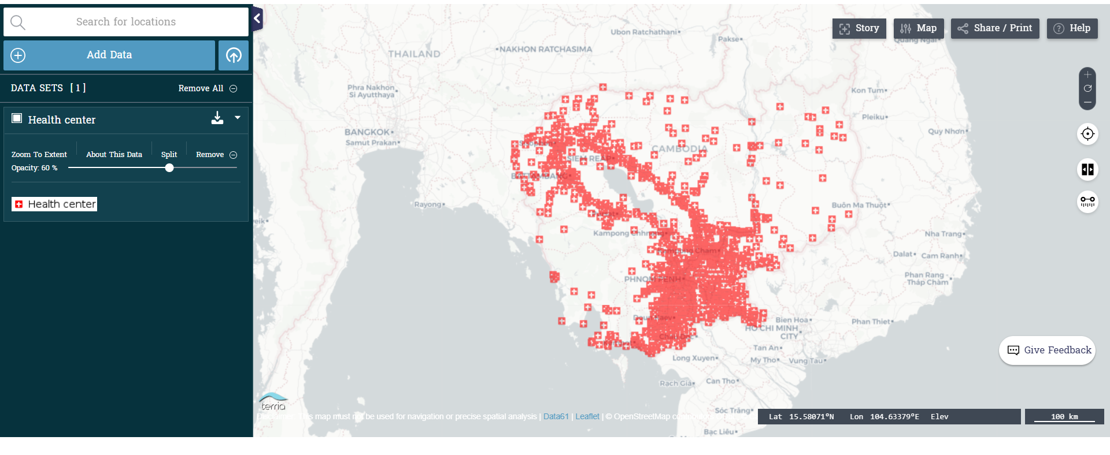
Number of Health Care Centers
https://data.opendevelopmentcambodia.net/dataset/health-facility-of-cambodia-2010/resource/f2ca35cd-340f-4dc5-a9e7-5c8fa72b6a21/view/c4325365-df35-468d-9df3-0dd46d960891

Slide 29
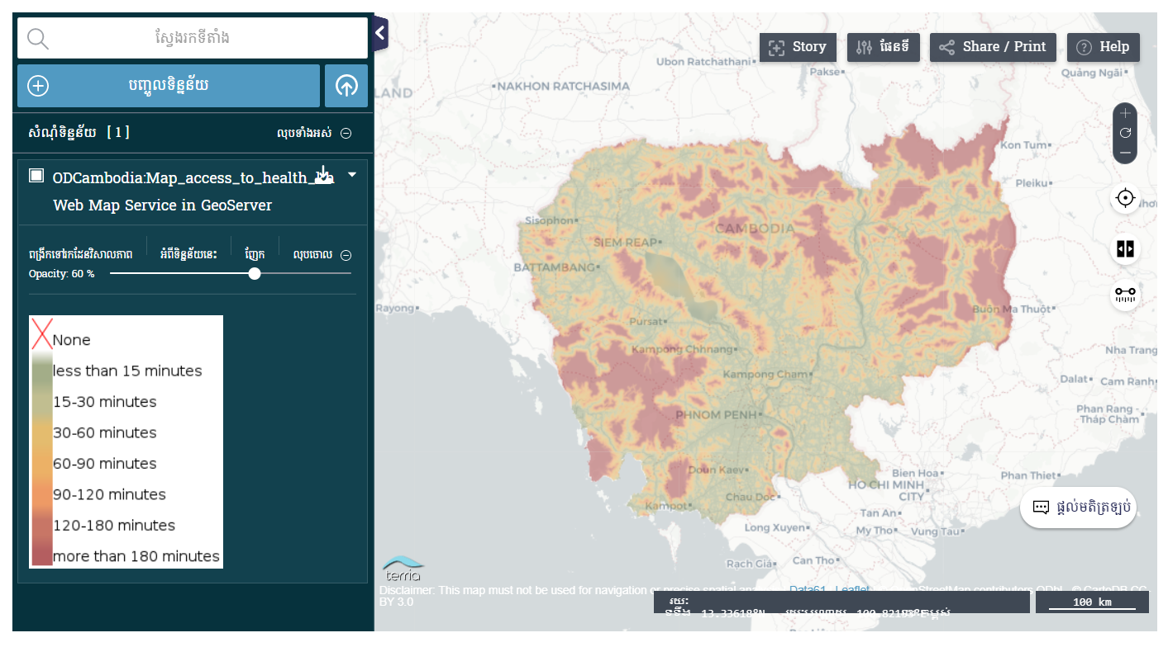
Distance from home to health care center (សំណុំទិន្នន័យនេះ ផ្តល់នូវព័ត៌មានទាក់ទងនឹង លទ្ធភាពដែលអាចទៅកាន់មណ្ឌលសុខភាព នៅទូទាំងប្រទេសកម្ពុជា ដោយដកស្រង់ចេញពី អង្គការសុខភាពពិភពលោក (WHO)។ អង្គការទិន្នន័យអំពីការអភិវឌ្ឍ...)

Slide 30
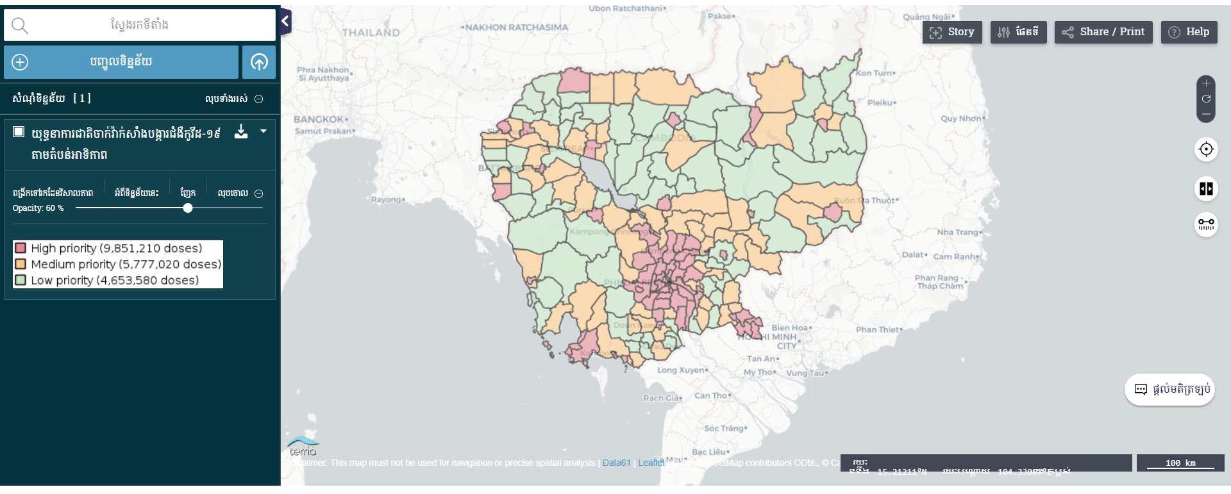
អំពីវិទ្យាស្ថានបច្ចេកវិទ្យាកម្ពុជា
Covid-19 Vaccination Action Plan

Slide 31
5.
Monitoring and Evaluation

Slide 32
Indicators Monitoring by denominators
2.2 | 2.3 | 2.4 | 3.3 | 3.4 | 3.6 | 3.8
Number of children whose weight for height z-score is two or more standard deviations (SD) below the median weight for height of a reference population | Total value of agricultural production (farming, livestock production and fisheries) in reporting year | Total Value of agricultural production ($) in the reporting year | Monitoring number of effected people | Number of deaths between ages 30 and 70 years in the year due to cardiovascular, cancers, diabetes, or chronic respiratory diseases in the year | Number of deaths population due to road accident in the reporting year | Number of people living under the poverty line who are covered by health equity funds (HEFs) in reporting year
Action 1
Action 3
Action 5
1
3
5
2
4
6
Action 2
Action 4
Action 6

Slide 34
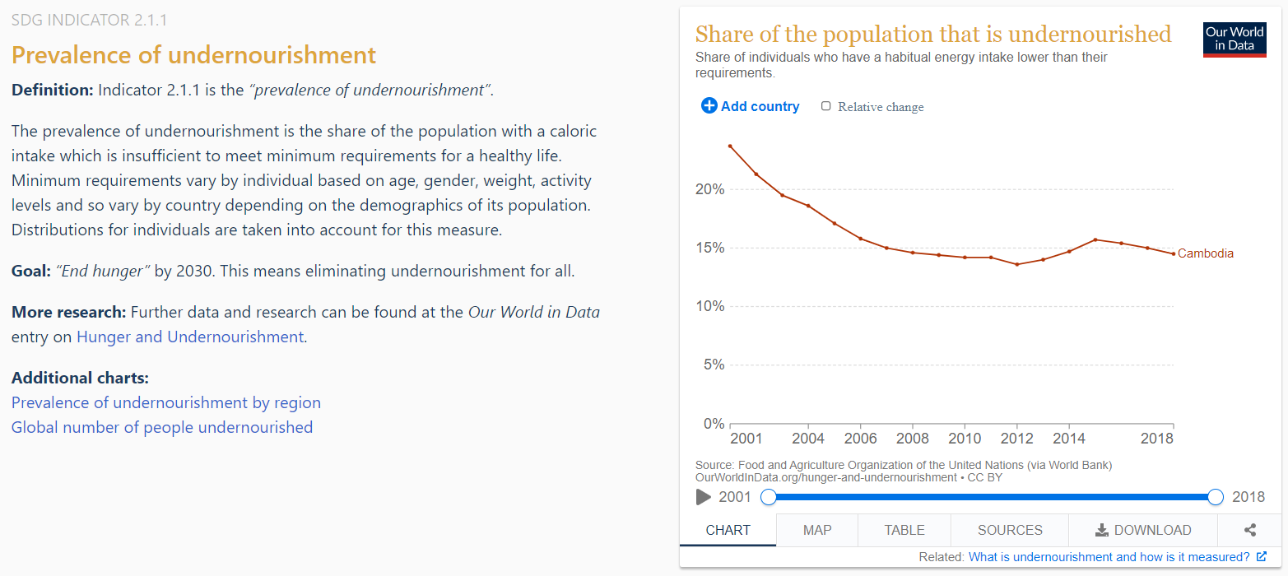

Slide 35
6.
Case Studies

Slide 36
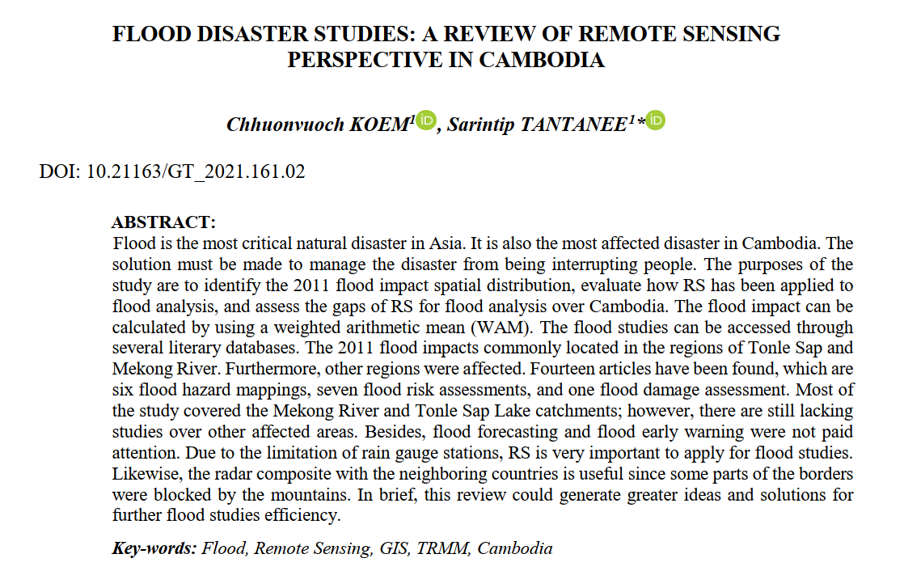
S
O
T

Slide 37
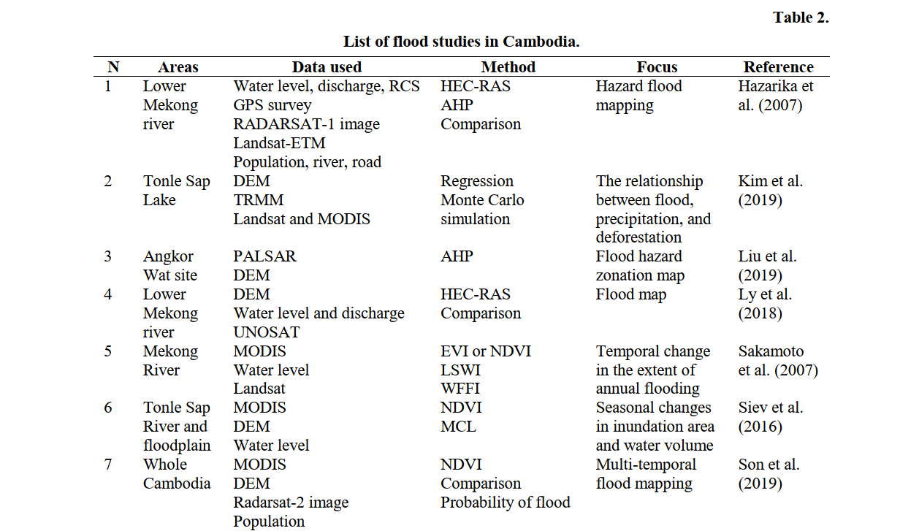
S
O
T

Slide 38
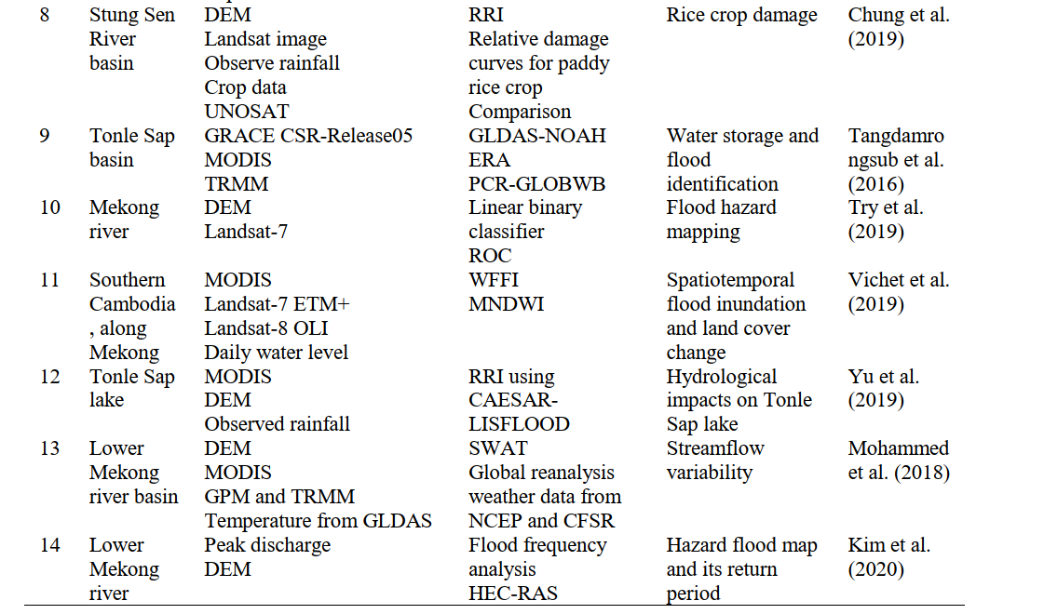
S
O
T

Slide 39


Thank You
CHAN Sophal Lecturer
Department of Applied Mathematics and Statistics
Institute of Technology of Cambodia (ITC)
PHAUK Sokkhey Lecturer
Department of Applied Mathematics and Statistics
Institute of Technology of Cambodia (ITC)

Slide 40
In 2018 the WHO adopted a five-year strategic plan to achieve the SDGs, particularly SDG 3. To track the impact of the strategic plan, a result framework has been established and is continuously being refined. The final version will be presented in January 2020.
The plan’s three targets, known together as the “triple billion” target, are:
Extending universal health coverage to one billion more people;
Ensuring better protection from health emergencies for one billion more people; and
Promoting better health and well-being for one billion more people.
S
O
T

Slide 41
The WHO is also promoting these six main lines of action to as a guideline to align efforts:
Intersectoral action by multiple stakeholders;
Health systems strengthening for UHC;
Respect for equity and human rights;
Sustainable financing;
Scientific research and innovation; and
Monitoring and evaluation.
S
O
T

Slide 42
Plan
Action 1
Action 3
Action 5
1
3
5
2
4
6
Action 2
Action 4
Action 6

Slide 43
Open Data Source (Link)

Slide 44
សំណុំទិន្នន័យជារ៉ាស្ទើនេះ ផ្តល់នូវព័ត៌មានទាក់ទងនឹង លទ្ធភាពដែលអាចទៅកាន់មណ្ឌលសុខភាព នៅទូទាំងប្រទេសកម្ពុជា ដោយដកស្រង់ចេញពី អង្គការសុខភាពពិភពលោក (WHO)។ អង្គការទិន្នន័យអំពីការអភិវឌ្ឍ...

Slide 45
អំពីវិទ្យាស្ថានបច្ចេកវិទ្យាកម្ពុជា
Covid-19 Vaccination Action Plan

Slide 46
Number of Health Care Centers
https://data.opendevelopmentcambodia.net/dataset/health-facility-of-cambodia-2010/resource/f2ca35cd-340f-4dc5-a9e7-5c8fa72b6a21/view/c4325365-df35-468d-9df3-0dd46d960891

Slide 47
Distance from home to health care center (សំណុំទិន្នន័យនេះ ផ្តល់នូវព័ត៌មានទាក់ទងនឹង លទ្ធភាពដែលអាចទៅកាន់មណ្ឌលសុខភាព នៅទូទាំងប្រទេសកម្ពុជា ដោយដកស្រង់ចេញពី អង្គការសុខភាពពិភពលោក (WHO)។ អង្គការទិន្នន័យអំពីការអភិវឌ្ឍ...)

Slide 48
អំពីវិទ្យាស្ថានបច្ចេកវិទ្យាកម្ពុជា
Covid-19 Vaccination Action Plan

Slide 49
Cambodia Team :
Agriculture and
Healthcare
The links between agriculture and health:
an intersectoral opportunity to improve the health

Slide 50
1.
Introduction

Slide 51
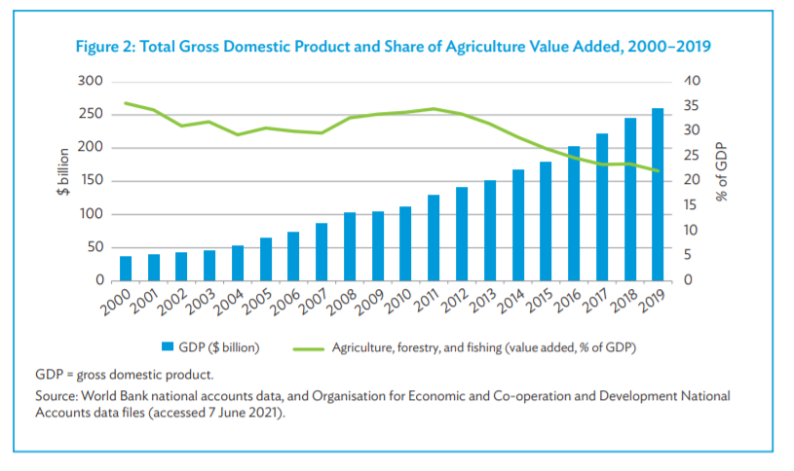
Agriculture in Cambodia
Agriculture remains the most important sector of the Cambodian economy in terms of its share of the gross domestic product (GDP), and it employs the vast majority of the workforce.

Slide 52
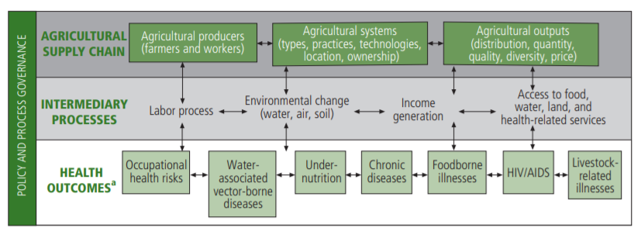
How is agriculture linked with healthcare?

Slide 53
How is agriculture linked with healthcare? Agriculture Supply chain
Agricultural Producers
The labor supplied by agricultural households interacts with health in several ways. First, labor influences nutritional status by affecting energy expenditure and the time available for child care and food preparation. Second, farming exposes producers to a range of occupational health hazards, such as dehydration, accidents, zoonoses, and acute and chronic pesticide poison. Third, the amount and type of agricultural employment has implications for the spread of and exposure to disease (e.g. HIV/AIDS) because it influences migration and the search for alternative income sources.8 All these interactions are affected by gender relations in agricultural communities.
Agriculture Output
Agricultural outputs are also linked with chronic diseases. Agricultural policies can create incentives or disincentive to the production of different foods, tobacco and alcohol, and in turn determine their prices, thus affecting the environment in which people make choices about these products, and their subsequent level of exposure to risk fact tors for chronic disease.
Another agricultural product is medicinal plants, many of which are believed to be effective in the treatment of certain diseases.

Slide 54
2.
Big Data in Agriculture

Slide 55
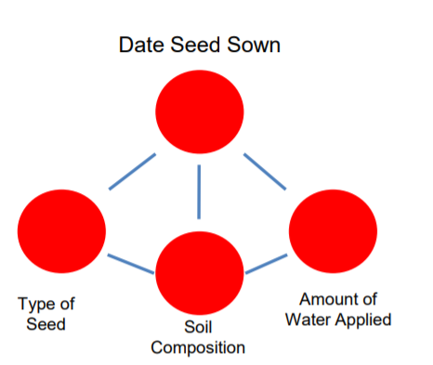
Supported datasets

Slide 56
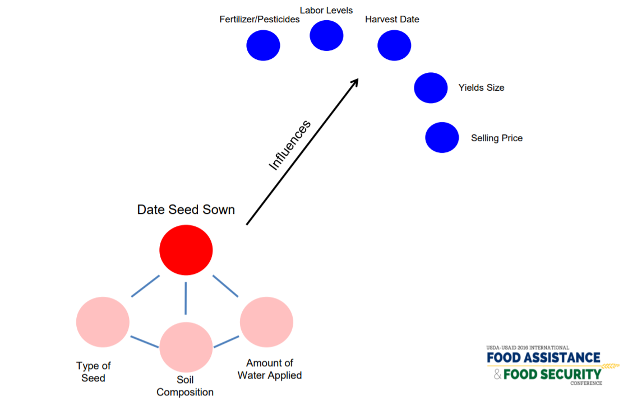
Supported datasets

Slide 57
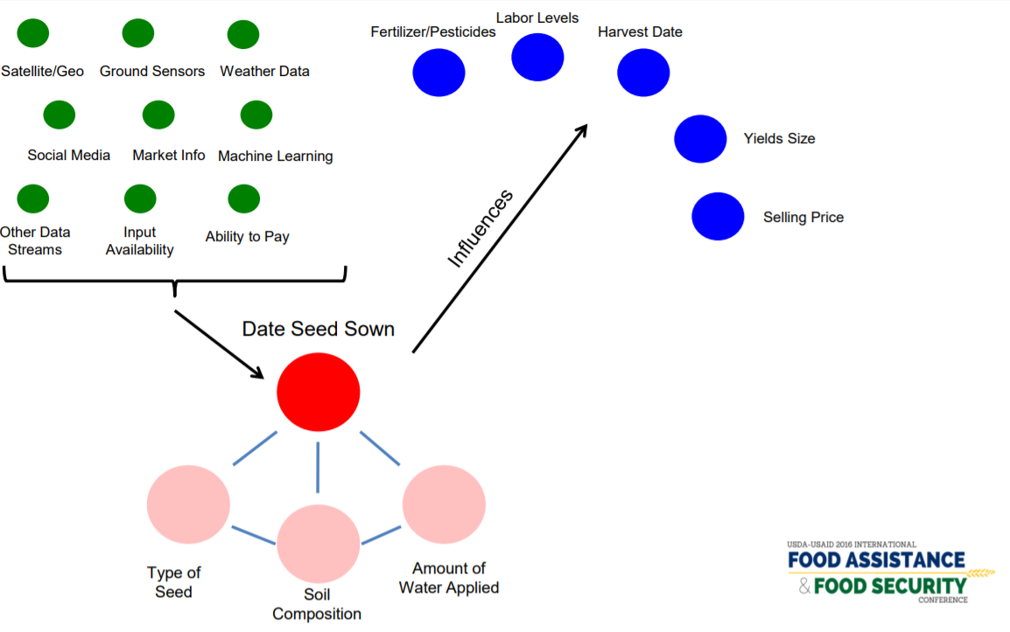
Supported datasets

Slide 58
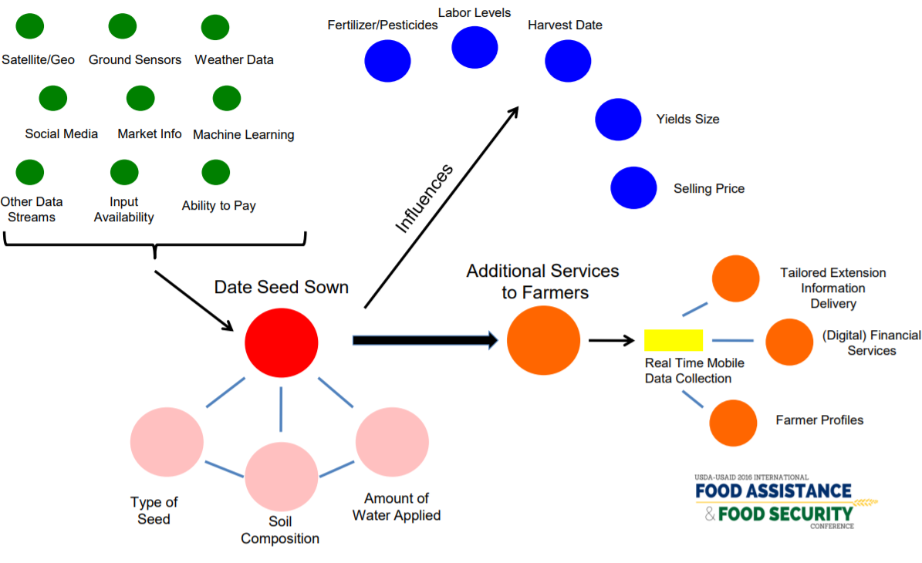
Supported Datasets

Slide 59
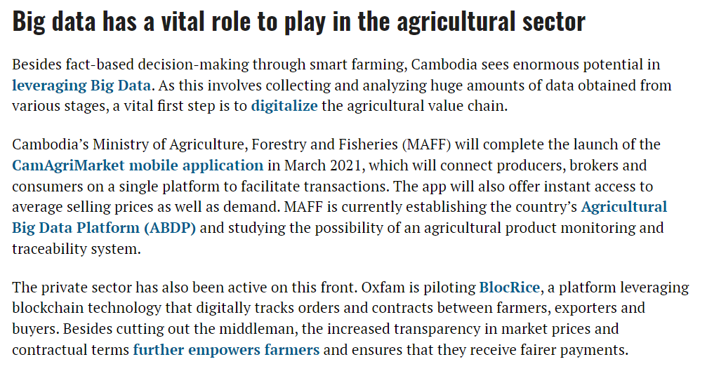

Slide 60
Comment
Whole Process from agriculture suppliers to customer
Insect/climate change/disease
Drone to collect big data

Slide 61
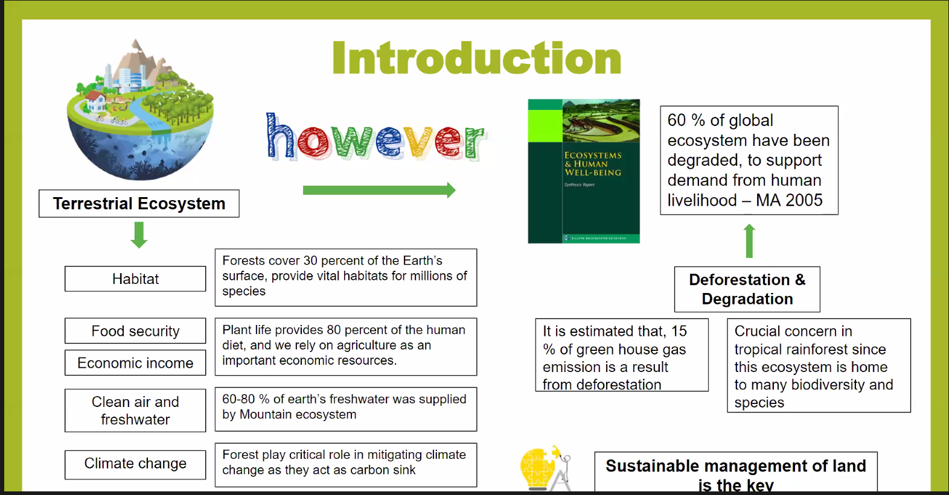

Slide 62
Conclusion
These links between agriculture and health present an opportunity for the two sectors to work together to find solutions to each other’s problems. Yet the health and agricultural sectors remain poorly coordinated. Leadership from global health and agricultural institutions is needed to build policies and good governance to facilitate integration, while capacity building is needed at all levels to help translate the conceptual links into comprehensive action on the ground. Health and agricultural researchers likewise need to work more closely together to achieve common goals.

Slide 63

Group 1-Cambodia
Human mobility data in the COVID-19 pandemic

Slide 64
COVID-19 (coronavirus) continues to spread globally and has reached Cambodia. Cambodia has taken early and decisive measures to prevent the inflow and spread of COVID-19.

Slide 65
Ministry of Health
Mobility datasets retrieved from public transit systems, such as bus, train, ferry, metro, and air flight, represent the aggregated human mobility. There are two types of public transit data: the scheduled timetable and the actual travel records of passengers.

Slide 66
The COVID-19 pandemic poses unprecedented challenges around the world. Many studies have applied mobility data to explore spatiotemporal trends over time, investigate associations with other variables, and predict or simulate the spread of COVID-19. Our objective was to provide a comprehensive overview of human mobility open data to guide researchers and policymakers in conducting data-driven evaluations and decision-making for the COVID-19 pandemic and other infectious disease outbreaks. We summarized the mobility data usage in COVID-19 studies by reviewing recent publications on COVID-19 and human mobility from a data-oriented perspective. We identified three major sources of mobility data: public transit systems, mobile operators, and mobile phone applications. Four approaches have been commonly used to estimate human mobility: public transit-based flow, social activity patterns, index-based mobility data, and social media-derived mobility data. We compared mobility datasets’ characteristics by assessing data privacy, quality, space–time coverage, high-performance data storage and processing, and accessibility. We also present challenges and future directions of using mobility data. This review makes a pivotal contribution to understanding the use of and access to human mobility data in the COVID-19 pandemic and future disease outbreaks.

Slide 67
Contents
Topic 1: What are the major disasters that Occur in you country?
Topic 2: How the big (or other) data can apply in Life/Environmental Sciences?

Slide 68
Flooding in Cambodia
The National Committee for Disaster Management (NCDM) estimated that flooding in 2013 caused more than $355 million in damage across agriculture, infrastructure and people’s homes. NCDM reported that the floods affected 377,354 households and 1.8 million individuals living in 20 provinces. The floods killed 168 people, the majority of whom were children.
In the worst flooding cases, public services such as education and health care delivery cannot function properly. Infrastructure such as road, water and irrigation systems and electricity distribution (where they exist) can be damaged or destroyed, adding to long-term impacts. Shrinking agriculture production after the 2013 floods was estimated to have reduced Cambodia’s GDP growth by over half a percentage point.
Flooding in 2000 affected almost 3.5 million people, including 85,000 families (387,000 people) temporarily evacuated from their homes and villages. There were 347 deaths, and total physical damage was estimated at US$150 million.

Slide 69
S
O
T

Slide 70
S
O
T

Slide 71
S
O
T

Slide 72
Flooding in Cambodia
The National Committee for Disaster Management (NCDM) estimated that flooding in 2013 caused more than $355 million in damage across agriculture, infrastructure and people’s homes. NCDM reported that the floods affected 377,354 households and 1.8 million individuals living in 20 provinces. The floods killed 168 people, the majority of whom were children.
In the worst flooding cases, public services such as education and health care delivery cannot function properly. Infrastructure such as road, water and irrigation systems and electricity distribution (where they exist) can be damaged or destroyed, adding to long-term impacts. Shrinking agriculture production after the 2013 floods was estimated to have reduced Cambodia’s GDP growth by over half a percentage point.
Flooding in 2000 affected almost 3.5 million people, including 85,000 families (387,000 people) temporarily evacuated from their homes and villages. There were 347 deaths, and total physical damage was estimated at US$150 million.

Slide 73
1.
Geospatial Big Data and SDGs

Slide 74
2.
SDGS and Interlinkage

Slide 75
Resource persons:
Dr. Xin Zhou, Research Leader, Integrated Sustainability Centre, Institute for Global Environmental Strategies (IGES)
Dr. Mustafa Moinuddin, Deputy Director, Integrated Sustainability Centre, Institute for Global Environmental Strategies (IGES)
Opening: (5 minutes) Introduction of this seminar and the resource persons
Part One: (80 minutes) SDGs interlinkages: Methodology and analysis
- Importance of integrated SDG planning and the existing practices at the national level
- Existing tools on SDG interlinkages
- IGES SDG Interlinkages Aanalysis & Visualisation Tool
o An overview of the Tool and its methodology
o A demo on the function of the Tool and how to use
o An example: SDG interlinkages at the river basin scale
- Knowledge gap in understanding the SDG interlinkages: Identification of SDG interlinkages from a large quantity of literature using Natural Language Processing techniques
- Data gaps for measuring environment-related SDGs and big data

Slide 76
- Some simple questions related to an integrated approach for climate policy-making will be shared with the participants to receive their views. Participants will fill out the online survey and submit back to the resource persons/organiser before the break. The questions and various views will be discussed further during the open discussion session. The collective opinions and discussion results will be summarised and put into an SDG interlinkages framework with a visualisation graph after the seminar, which will be shared with the participants through the organiser.
Break (10 minutes)
Part Two: (60 minutes) Applications of SDGs interlinkages and case studies
- Integrated priority setting for SDGs planning and implementation: A practical case study in Bangladesh
- Integration of climate actions and SDGs at the sub-national scale: Results from stakeholders consultation in West Java
Q&A (10 minutes)
Part 3: (45 minutes) Open discussions
- Open floor discussions moderated by the resource persons based on the survey results

Slide 77
5. Deep Learning and Big Data

Slide 78
Big concept
Bring the attention of your audience over a key concept using icons or illustrations

Slide 79
You can also split your content
White
Is the color of milk and fresh snow, the color produced by the combination of all the colors of the visible spectrum.
Black
Is the color of ebony and of outer space. It has been the symbolic color of elegance, solemnity and authority.

Slide 80
In two or three columns
Yellow
Is the color of gold, butter and ripe lemons. In the spectrum of visible light, yellow is found between green and orange.
Blue
Is the colour of the clear sky and the deep sea. It is located between violet and green on the optical spectrum.
Red
Is the color of blood, and because of this it has historically been associated with sacrifice, danger and courage.

Slide 81

A picture is worth a thousand words
A complex idea can be conveyed with just a single still image, namely making it possible to absorb large amounts of data quickly.

